Slide 1

HR Luminary
June 2024

Slide 2
Agenda
Proposed architecture for integration
Description product
Cost estimate

Slide 3
Proposed Architecture for Integration

Slide 4
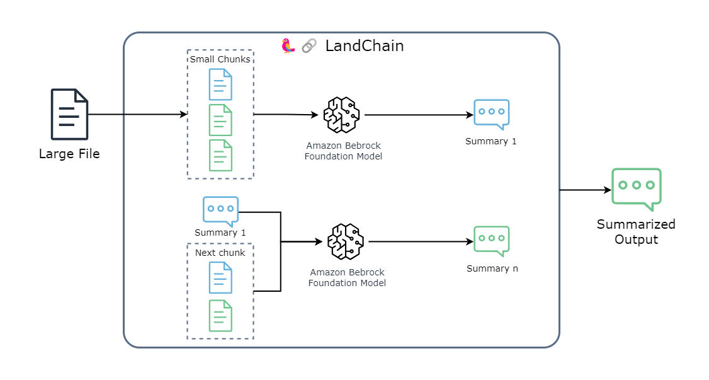
High Level Architecture

Slide 5
Description Product

Slide 6
Description Product
HR Luminary is a web-based application designed to analyze and provide insights into resumes. It leverages advanced AI models, including Amazon Bedrock and the Anthropic Claude model, integrated with the LangChain library, to help users quickly understand the strengths and weaknesses of a resume. This tool is ideal for HR professionals and recruiters who want to streamline their resume screening process.

Slide 7
AWS Infrastructure Cost Estimation

Slide 8
Assumptions
Using LLM: Claude 3 Sonnet
Estimated Number of Users: 1000

Slide 9
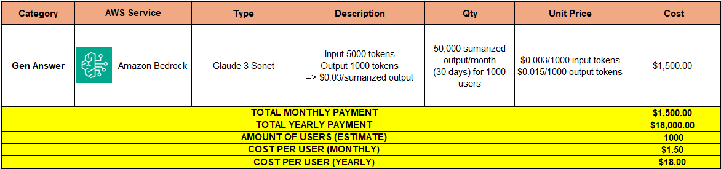
Cost for AI Model LLM

